Slide 1
PR- 28
Signal Processing Primitives With Quantum Algorithm
G-RIS
(G=Gal Winer(Team Lead), R=Risav, I= Ibrahim)

Slide 2
Presentation Flow
We won’t take your much time. The flow of the Presentation Would be in Following Order
Overview of Signal Processing
Image Filtering We have In Classical World
Mean Filter
Hybrid Algorithm For Mean Filter
Quantum Image Representation
NEQR and ENEQR
Outputs and Comparison of NEQR and ENEQR
Explanation and Simulation of the SubKeys
Whole Quantum Circuit for Quantum Mean Filter
Conclusion and possible modification that can be done

Slide 3
Signal Processing
Signal processing is a field of study that focuses on the analysis, manipulation, and interpretation of signals.
The main goal of signal processing is to extract relevant information from signals, enhance their quality, or compress them for efficient storage and transmission
It continues to evolve with advancements in mathematics, computing, and interdisciplinary collaborations, contributing to innovations that impact various aspects of modern life.

Slide 4
Why Signal Processing?
Signal processing is important for several reasons across a wide range of fields. Here are some key reasons why signal processing holds significance:
Information Extraction: Signal processing allows for the extraction of valuable information from signals, which may be essential for decision-making, analysis, or control in various applications. For example, in telecommunications, signal processing is used to extract data from noisy communication channels.
Noise Reduction and Enhancement: In many real-world scenarios, signals are corrupted by noise or unwanted disturbances. Signal processing techniques, such as filtering and denoising, help reduce or eliminate noise, enhancing the quality and reliability of the information.
Communication Systems: Signal processing is fundamental to the design and optimization of communication systems. It ensures the accurate and reliable transmission of information over various communication channels, including wireless and wired networks.
…etc

Slide 5
Image Filtering We Have In Classical World
The Image Filtering are based on mathematical operations and algorithms. Some of the popular and common image filtering methods are:-
Mean Filter(Blur or Smoothing ):
Removes high-frequency noise by averaging pixel values in neighborhood
Edge Detection Filters :
Highlight edges in images
Median Filter:
Replaces each pixel value with the median value in its local neighborhood.

Slide 6
Hybrid Realization of Quantum Mean Filters with Different Sized on E-NEQR Quantum Images by QFT Based Operations

Slide 7
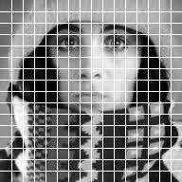
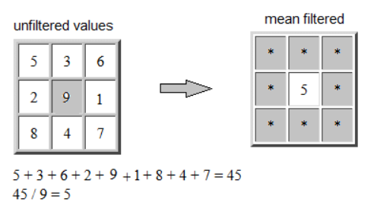
Mean Filter
A mean filter, also known as an averaging filter, is a common image processing technique used to reduce noise and enhance the quality of an image. It works by replacing each pixel's value with the average of the pixel values in its neighborhood. The neighborhood is typically defined by a small square or rectangular window around each pixel.

Slide 8
Hybrid Algorithm For Mean Filter
Our Algorithm goes as
Conversion of image to E-NEQR Image
Applying the filter Algorithm
If pixel are boundary of image then :
Copying the pixel without averaging
Else
Apply the QVyx circuit
Measure the circuit and filter out the Pixel whose probability are of 1/(image size)^2
+- 2 sigma
Reshape the array and convert array back to the circuit

Slide 9
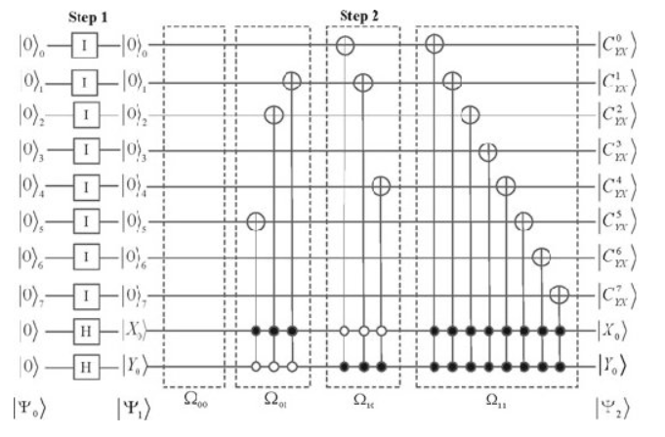
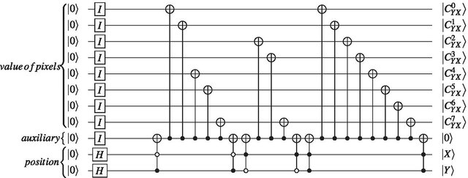
Quantum Image Representation
NEQR and ENEQR
The method uses an image pixel values are mapped to real kets in Hilbert space using block-structured addressing systems.
NEQR Circuit Representation
ENEQR Circuit Representation

Slide 10
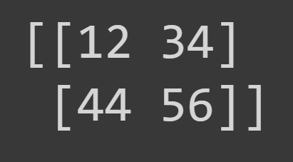
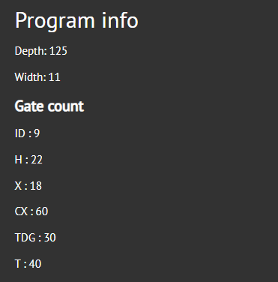
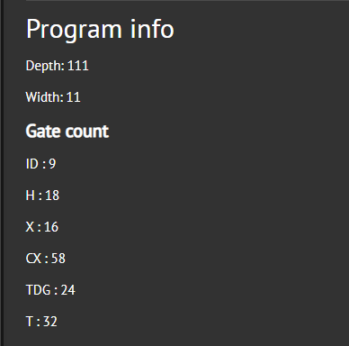
Why We Choose E-NEQR?
NEQR
ENEQR

Slide 11
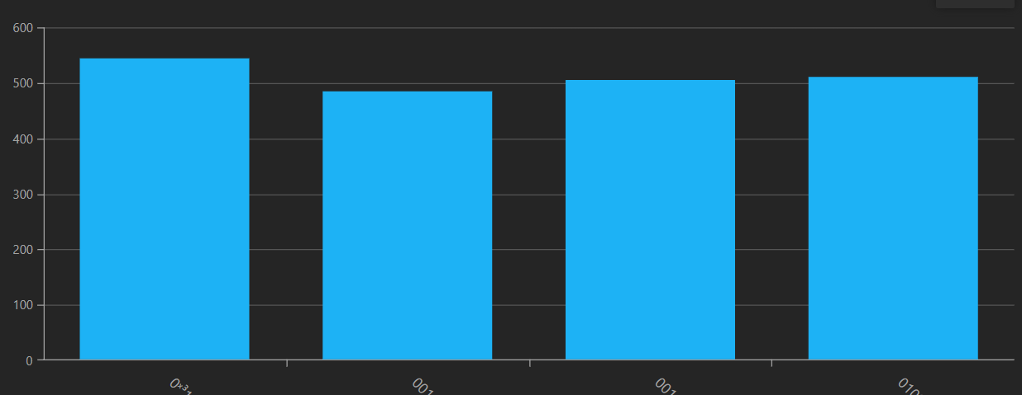
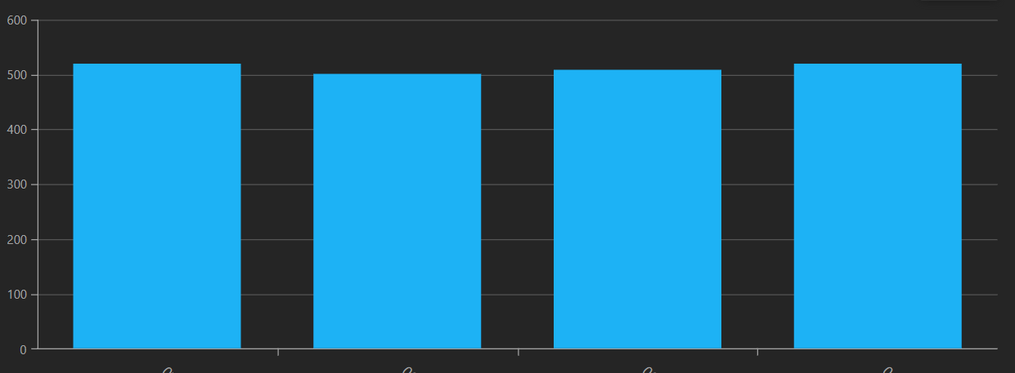
Result Of Execution
Execution result of NEQR
Where you can see there is no equal probability of the outcome
Execution result of ENEQR
Where you can see there is almost equal probability of the outcome

Slide 12
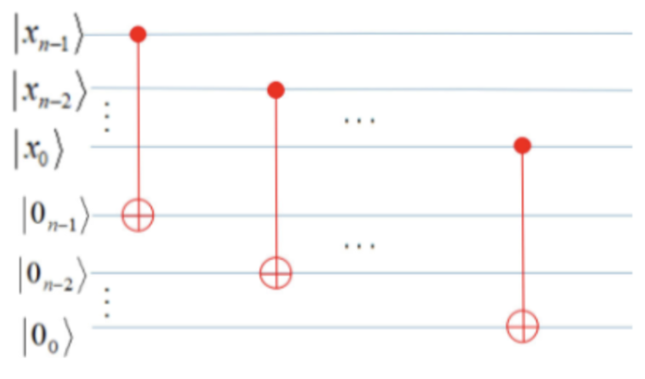
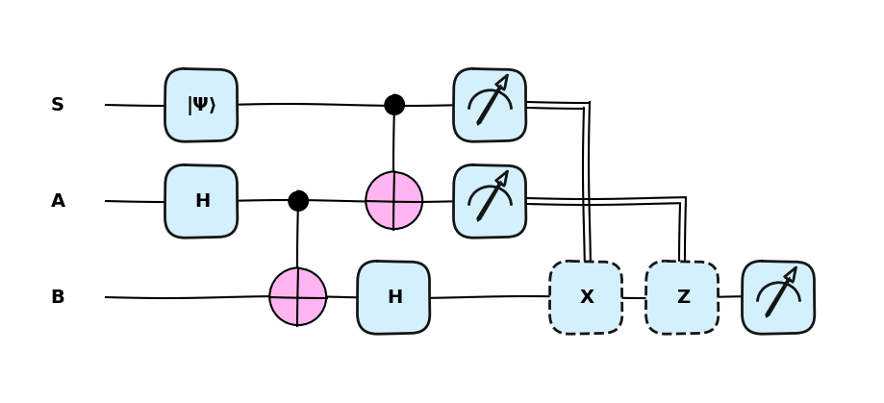
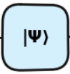
Copy module
For copying state there are two models
From Quantum Tunneling
From Series of CNOT Gate
Circuit for Quantum Teleportation
But the problem is we would loss the value from which we have teleported thus is incompatible with our Project
Circuit for Quantum Copy Module
And the state is preserve.

Slide 13
Question : Doesn’t this Violate No-Cloning Theorem??
No-Cloning Theorem states that it is impossible to create an identical copy of an arbitrary unknown quantum state.No-Cloning theorem is the General representation.
CNOT can only copy certain states: those in the computational basis (|0⟩ and |1⟩).This is allowed under the No-Cloning theorem, which only prohibits copying arbitrary unknown states.
It can't copy arbitrary superposition states (like α|0⟩ + β|1⟩).
Since, We are working with ENEQR which is the Z basis operation and there is no probabilistic representation.
This copy module doesn’t work if we work with the probabilistic representation like FQRI which encodes on X-basis.

Slide 14
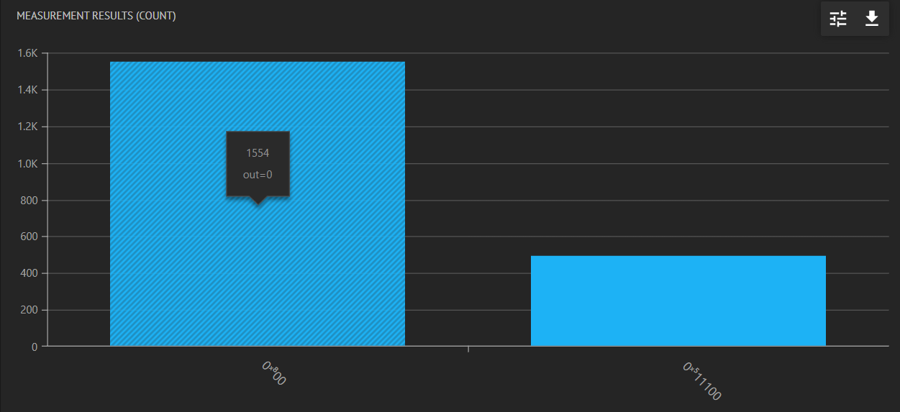
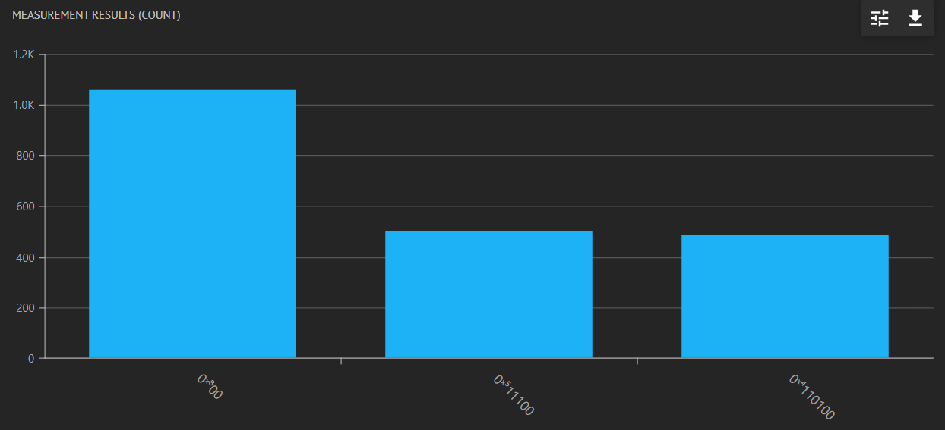
Simulation of Copy Module
Copying only one Pixel position.
Copying only two Pixel position.
Wondering why there is 00 for the rest of the output. As we have separate Register for the filtered image. So, only the pixel we have other qubit in state 0 but available state is copied

Slide 15
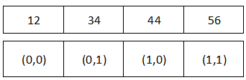
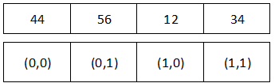
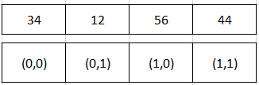
Cyclic Shift Operation
It is a bitwise operation that involves shifting the bits of a binary number to the left or right by a specified number of positions.
Cyclic shift X Right
Cyclic shift X Right

Slide 16
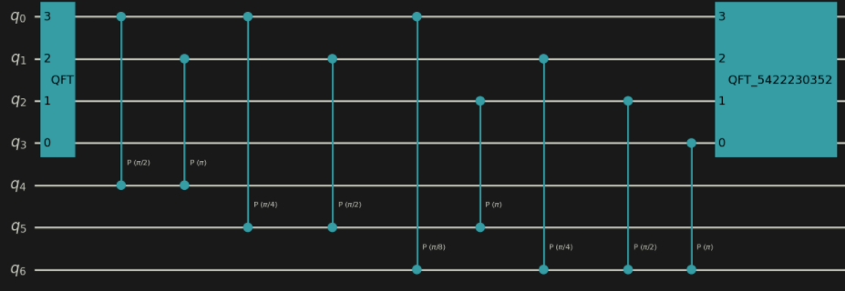
QFT based Addition
The procedure for applying this change is as follows
1. We apply QFT to the Sum Register and convert
the state from Computational basis to Fourier basis.
2. We will apply controlled rotation to the jth qubit of the Sum Register, which leads to new phase of 2(m+k) 𝜋/2 ˆj
3.We then return to the mathematical basis using Inverse QFT to obtain the combination (m+k).

Slide 17
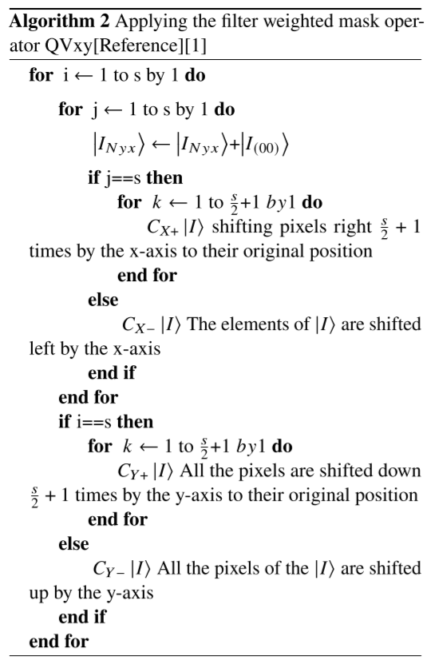
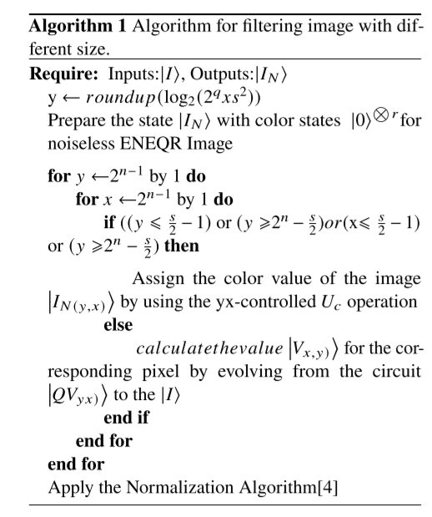
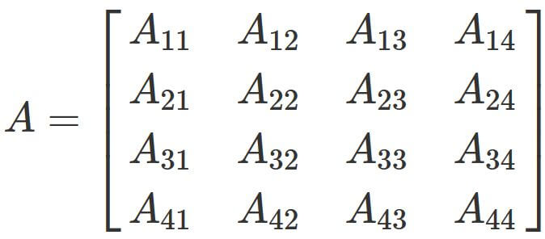
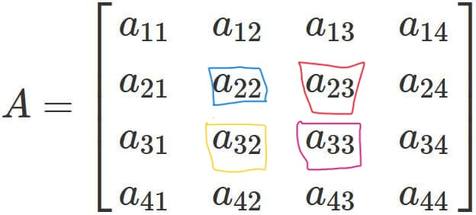
Working

Slide 18
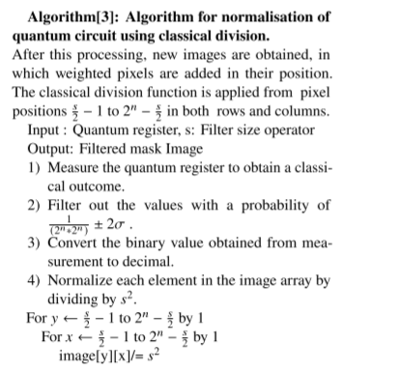
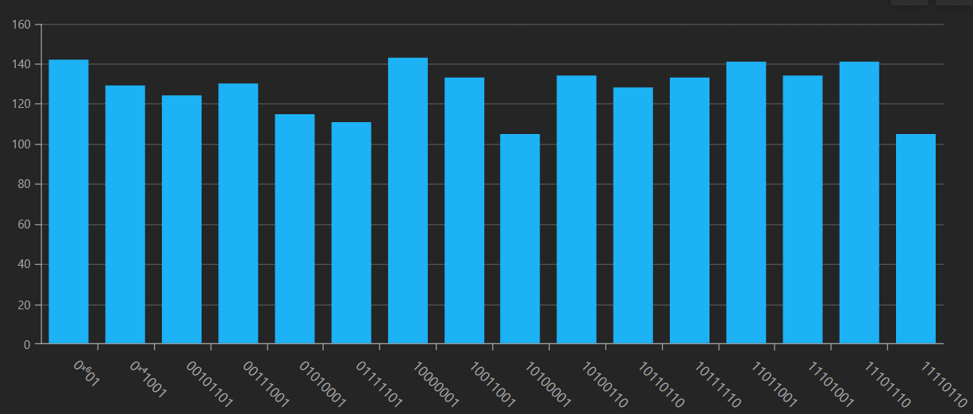
Classical Normalization

Slide 19
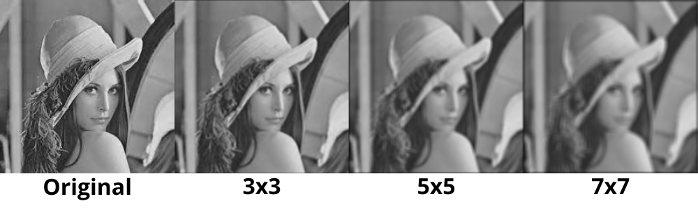

Resulting outcome

Slide 20
Future Works
Working with GQIR Model which can represent any size image to Quantum Circuit
Working with the Quantum Non-modular floating point division
For other signal processing works
Working with the Zero-Crossing, Low-Pass Filter…etc
Possibly modeling Gravitational Wave Using QML approach

Slide 21
Thank you for Listening
Special Thank to the Classiq team, QWorld ,Gal Winer and Abu

